Slide 1
Scientific Paper Review
Large Language Models for Intelligent Transportation Systems
& Federated Learning for Connected and Automated Vehicles
Ankit Gupta
January 2025

Slide 2
Overview
Paper 1
Paper 2
LLMs for Intelligent
Transportation Systems
Federated Learning for
Connected & Automated Vehicles
Introduction & Objectives
Methodology & Framework
Key Results (5 Categories)
Challenges & Future Directions
Introduction & Objectives
FL Framework & Architecture
Applications in CAV Tasks
Challenges & Future Directions
Comparison & Key Takeaways

Slide 3
PAPER 1
Large Language Models for
Intelligent Transportation
A Review of the State of the Art and Challenges
Wandelt et al. | Applied Sciences (MDPI) | August 2024

Slide 4
Paper 1: Objectives
Primary Goal
Provide a comprehensive overview of LLM applications in Intelligent Transportation Systems (ITS), identify key challenges, and propose future research directions.
01
02
03
Categorize Literature
Identify Challenges
Guide Future Research
Survey 130+ papers and systematically group them into meaningful categories
Analyze barriers to LLM adoption in transportation systems
Propose actionable research directions for the emerging field

Slide 5
Paper 1: Methodology & Framework
Technical Foundations
Review Approach
Transformer Architecture
Self-Attention Mechanism
Encoder-Decoder Structure
Pre-training & Fine-tuning
130+ papers analyzed
Post-ChatGPT era (2023-2024)
Multi-domain coverage
Systematic categorization
5-Category Taxonomy of LLM Applications in ITS
Autonomous
Driving
LLMs
for ITS
Traffic
Safety
Tourism
Others

Slide 6
Paper 1: Key Applications by Category
Category | Key Applications | Technologies
Autonomous Driving | Decision-making, User interaction, Environmental perception, Motion planning | GPT-4, MLLMs, VLMs, Talk2BEV
Safety | Accident report classification, Risk assessment, Factor identification | Aviation-BERT, SafeAeroBERT, TrafficSafetyGPT
Tourism | Trip planning, Personalized recommendations, Multilingual communication | ChatGPT, Gemini, Custom chatbots
Traffic | Signal control, Flow prediction, Monitoring, Behavior prediction | TrafficBERT, CALM, BERT-based models
Others | Logistics, Supply chain, Aviation QA systems, Education | GPT-3 Codex, aeroBERT, Domain-specific LLMs

Slide 7
Paper 1: Challenges & Future Directions
1. Open-Source & Reproducibility
2. Human-Machine Interaction
3. Real-Time Capabilities
Closed-source LLMs create ethical risks and reproducibility issues
Natural communication between humans and autonomous systems
Latency issues for time-critical transportation decisions
4. Multi-Modal Integration
5. Verification & Validation
6. Ethical Considerations
Processing images, video, audio, and sensor data together
Formal testing protocols for safety-critical applications
Bias, privacy, accountability, and regulatory compliance
My Understanding: Use open-source models, develop domain-specific benchmarks, and prioritize multi-modal integration with real-time processing capabilities.

Slide 8
PAPER 2
Federated Learning for
Connected & Automated Vehicles
A Survey on Privacy-Preserving Collaborative Learning
Chellapandi et al. | arXiv | March 2023

Slide 9
Paper 2: Objectives
Primary Goal
Survey Federated Learning (FL) applications in Connected and Automated Vehicles (CAVs) to enable privacy-preserving collaborative model development across vehicle fleets.
01
02
03
Review FL Algorithms
Analyze CAV Applications
Identify Challenges
Analyze FL algorithms applicable to CAV tasks including FedAvg, FedProx, and personalized FL
Examine FL in Perception, Motion Planning, and Motion Control tasks
Highlight open challenges and research opportunities in FL for CAVs

Slide 10
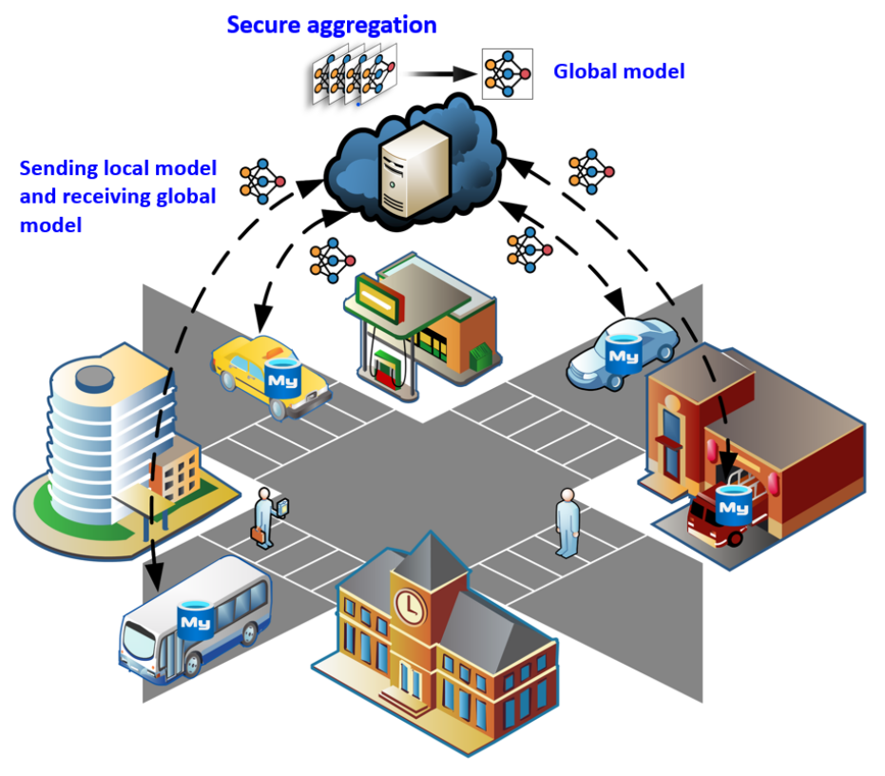
Paper 2: Federated Learning Framework
FL Architecture for CAVs
FL Training Process
Central Server
(lobal Model)
1
Initialize:
Server initializes global model
2
Distribute:
Global model sent to vehicles
3
Local Training:
Each vehicle trains on local data
Vehicle 1
Local Data
Vehicle 2
Local Data
Vehicle N
Local Data
4
Upload:
Model updates sent to server
5
Aggregate:
Server aggregates updates (FedAvg)
6
Iterate:
Repeat until convergence

Slide 11
Paper 2: Key Applications by CAV
CAV Task | FL Applications | Key Benefits
Perception | Object detection, Lane detection, Semantic segmentation, Sensor fusion | Learn from diverse visual scenarios across fleet
Motion Planning | Path planning, Trajectory prediction, Behavior prediction, Route optimization | Improved decision-making from collective experience
Motion Control | Steering control, Speed control, Braking systems, Vehicle dynamics | Robust control across vehicle types
V2X Communication | Resource allocation, Channel estimation, Spectrum management | Privacy-preserving network optimization
Traffic Prediction | Flow prediction, Congestion detection, Incident prediction | City-wide learning without data centralization

Slide 12
Paper 2: Challenges & Future Directions
1. Data Heterogeneity
2. Communication Overhead
3. System Heterogeneity
Non-IID data distribution across vehicles affects model convergence
Limited bandwidth in vehicular networks for model updates
Different computing capabilities across vehicle types
4. Security Attacks
5. Real-Time Constraints
6. Scalability Issues
Vulnerability to poisoning and inference attacks
Safety-critical decisions require low latency updates
Handling millions of vehicles in a single FL system
My Understanding: Explore personalized FL, hierarchical architectures, secure aggregations, and edge computing integration for real-time CAV applications.

Slide 13
Comparison & Synergies
Aspect | Paper 1: LLMs for ITS | Paper 2: FL for CAVs
Paper Type | Comprehensive Review (130+ papers) | Survey Paper
Core Technology | Large Language Models, Transformers | Federated Learning, Distributed ML
Main Focus | NLP-based intelligence for ITS | Privacy-preserving collaborative learning
Key Applications | Autonomous driving, Safety, Tourism, Traffic | Perception, Motion Planning, Control
Privacy Concern | User data in LLM interactions | Vehicle sensor data protection
Main Challenge | Real-time processing, Explainability | Data heterogeneity, Communication
Potential Synergy: Federated SLMs for ITS
Combining FL with SLMs could enable privacy-preserving training of language models across vehicle fleets. Vehicles could collaboratively improve SLM-based driving assistants without sharing sensitive user interactions or driving data.

Slide 14
Key Takeaways
1.
LLMs are transforming ITS across autonomous driving, safety, tourism, and traffic management
2.
Federated Learning enables privacy-preserving collaborative ML for connected vehicles
3.
Both technologies address critical needs: intelligence (LLMs) and privacy (FL)
4.
Key challenges include real-time processing, data heterogeneity, and security
5.
Future research opportunity: Federated LLMs for intelligent transportation
Thank You

